Slide 1
Megacompany Employee Churn Meets 401(k) Vesting Schedules: A Sabotage on Workers’ Retirement Wealth 41 Yale L. & Pol. Rev. 1 (2022)
Samantha J. Prince
Asst. Professor of Law
sjp15@psu.edu

Slide 2
Retirement Policy
Assure that individuals who have spent their careers in useful and socially productive work will have adequate incomes to meet their needs when they retire
Improve the fairness and effectiveness of qualified retirement plans
Make the tax laws relating to qualified retirement plans fairer by providing greater equality of treatment under such plans for the different taxpayer groups concerned.
© Samantha Prince 2024

Slide 3
Saving for Retirement in a 401(k) Plan
Employee contributes
Retirement Fund
Retirement fund grows via contributions and investment growth
Employee Wages
Growth
Employer contributes
© Samantha Prince 2024

Slide 4
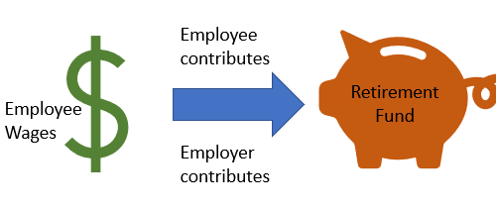
Vesting and Forfeitures
Employees are 100% vested in their own contributions.
Employer contributions (matching or other kinds) can be subject to a vesting schedule.
2-6 graded
3-year cliff
Immediate
Other
When someone terminates before they are 100% vested, their unvested amounts are forfeited.
Most companies use the forfeited amounts to
Reduce future employer contributions, and/or
Reduce administrative expenses
2-6 Graded
Year 1 0%
Year 2 20%
Year 3 40%
Year 4 60%
Year 5 80%
Year 6 100%
3-Year Cliff
Year 1 0%
Year 2 0%
Year 3 100%
© Samantha Prince 2024

Slide 5
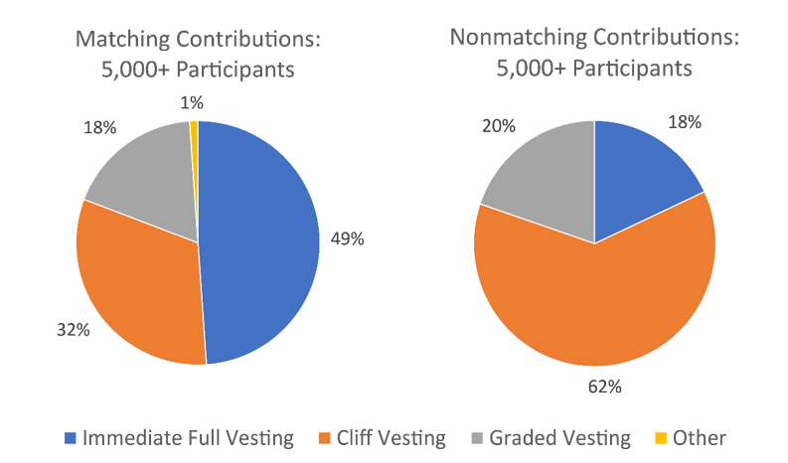
Large Plan Vesting Schedules
© Samantha Prince 2024

Slide 6
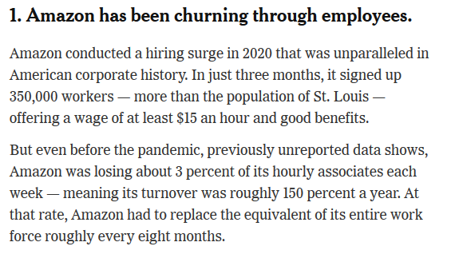
Amazon
© Samantha Prince 2024

Slide 7
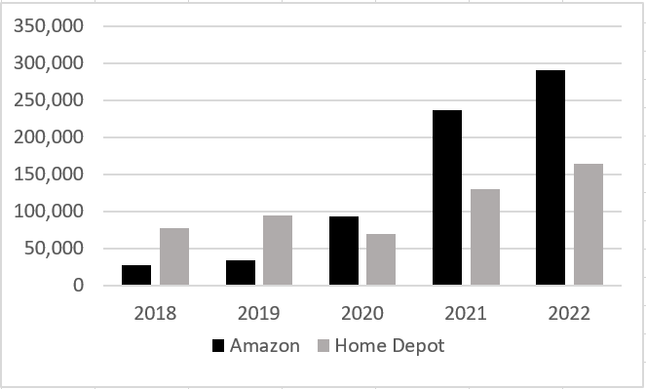
Amazon & Home Depot 401(k) Plans
Bezos philosophy – “entrenched workforce” is a “march to mediocrity” - seeks to ensure high employee turnover by maintaining tough working conditions & not giving annual raises after 3 years.
3-Year Cliff
Year 1 0%
Year 2 0%
Year 3 100%
Number of employees terminated prior to vesting
289,820
236,751
163,990
92,861
© Samantha Prince 2024

Slide 8
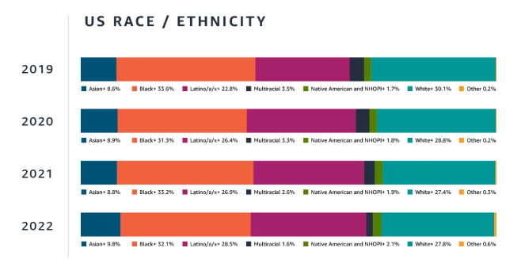
Amazon Demographics – Field & Customer Support
© Samantha Prince 2024
https://www.aboutamazon.com/news/workplace/our-workforce-data
Notes:
Greater impact on POC.

Slide 9
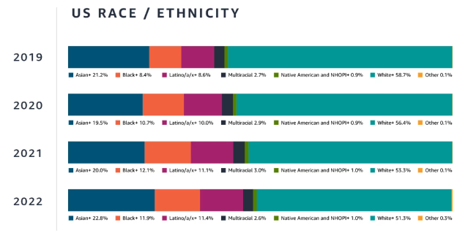
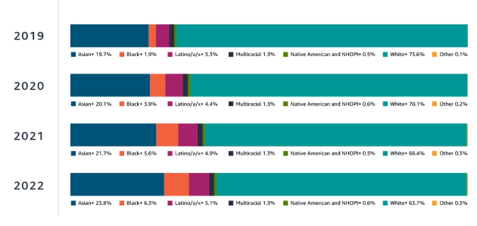
Amazon Demographics cont.
People Managers
Senior Leaders
© Samantha Prince 2024
https://www.aboutamazon.com/news/workplace/our-workforce-data
Notes:
Greater impact on POC.

Slide 10
Retirement Wealth Inequality
Generational Wealth Inequality
“The ability to transfer wealth inter-generationally helps subsequent generations of White families build wealth through large financial gifts and inheritances more so than families of color.”
Financial Illiteracy
“Financial literacy is not a sideshow . . . it plays a critical role in saving and wealth accumulation.”
© Samantha Prince 2024

Slide 11
Pres. Biden’s EO on Advancing Racial Equity and Support of Underserved Communities through the Federal Government
Directs Agencies to…
“identif[y] inadequacies in existing Federal data collection programs, policies, and infrastructure across agencies, and strategies for addressing any deficiencies identified.”
“Many federal datasets are not disaggregated by race, ethnicity, gender, disability, income, veteran status, or other key demographic variables. This lack of data has cascading effects and impedes efforts to measure and advance equity. A first step to promoting equity in government action is to gather the data necessary to inform that effort.”
© Samantha Prince 2024

Slide 12
From Immediate Vesting to Vesting Schedules
Wells Fargo changed from immediate vesting for its matching contributions to a three-year cliff schedule. (Effective Jan. 1, 2021)
1,433 terminated without being fully vested in 2022.
Cognizant Technology Solutions had immediate vesting but changed to some sort of five-year graded schedule. (Effective Jan. 1, 2022)
284 terminated without being fully vested in 2022.
© Samantha Prince 2024

Slide 13
Recommendations
Increase demographic data collection
Eliminate vesting schedules or reduce to one-year cliff
Mandate that high turnover triggers 100% vesting

