Slide 1
Administrative Role in Using and Limiting Generative AI

Slide 2
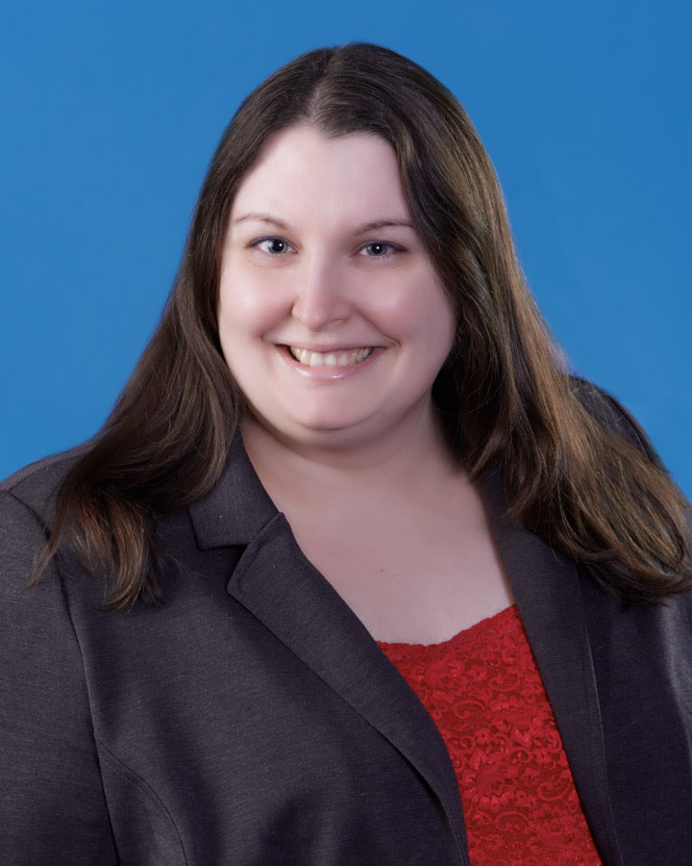
Presenters
Rachelle Holmes Perkins
Jenny WOndracek
George Mason University Law School
Capital University Law School
Notes:
Each introduce ourselves

Slide 3
Major Points for this Conversation
Policies
Training
Assessment
Regulation/Enforcement
External Influences and Expectations
The Future
Notes:
Agenda for what we are going to discuss - JW

Slide 4
Widespread Impact around the Law School
Professors:
Determine use in classes and exams; use in scholarly articles for publication; clinics have special concerns
Library:
Exploring available technologies; developing norms around best practices and uses; training
Students:
Classroom uses; journals; exams; writing samples
Records:
Administration of exams (format and security)
Information Technology:
Detection software; exam security; latest technologies
Career Services:
Advising students on resumes, cover letters, writing samples
Admissions:
Applications and personal statements
Communications:
Use of AI to generate emails, newsletters, articles, publicity
Notes:
RP – The reason the administrative role in using and limiting generative AI is so complex is because it touches every aspect of law school governance and structure

Slide 5
Policies
Students
Faculty
Other Law School Constituents
Clinics
Notes:
Students – JW
Different restrictions for Lexis/West vs Chat?
Needed changes from F23 stopgap policies
Ethical implications
Interfere with learning
Faculty – RP
Faculty have already started to raise questions about the use of AI in scholarly articles and how the expectations around productivity and our use exist with respect to junior faculty. Even if you don’t’ have an official policy, it is a conversation worth having with faculty because what you don’t want to happen is for a candidate to come up for promotion or tenure and the senior faculty ask whether or not AI was used in the article and it becomes a problem where they are discounting their work in some way. We’ve also discussed as institution what expectations for use in creating exam and/or quiz questions, Letters of Rec for jobs and clerkships, etc…. Those weren’t as much policies but at least starting the conversations around best practices.
Clinics - JW
Other – RP
Other LS groups such as journals, career services, communications team have also all asked about expectations around permissible uses and expectations. It can make them more efficient at their work (e.g. generating a newsletter), donor thank you letters, but explaining that everything has to be checked and vetted or whatever procedures/expectations you determine should be explicitly communicated; moot court;

Slide 6
Training
Students
Faculty
Other Law School Constituents
Notes:
Students – JW
Faculty – RP
Has to be required. You cannot monitor, incorporate or assess work product that has used generative AI if you don’t understand how it works, what it can and cannot do, and what type of outputs it generates. As such, I am going to require all FT faculty to have a basic training on use. We already had an optional one done in conjunction with our research Dean and our librarian in the fall for ChatGPT, but this will be required. Understanding the research (Dan Schwarz and UM) about how it affects student performance is also important. How you use and what you allow.
Outputs
Other – Clinics and other people at law school - JW

Slide 7
Assessments
Research and Writing Courses
Non-Paper Based Courses
Notes:
Research & Writing – JW
Non-Paper Courses – RP (Firms and 1L grades)
Even with respect to PCs, alternative assessment formats like more emphasis on in class presentations or contributions, in addition to the final paper may be appropriate.
Professors for non paper course still need to understand the tools available to students because it should affect their assessments and testing format. We require secure exams for all of our required doctrinal courses. This is consistent with feedback we have received from partners at firms who while wanting law students to learn how to responsibly and effectively use GAI in their work, also want to know and evaluate that the students have the legal skills to add value on top of what AI can do.
We have definitely seen uptick in more reliance on in person exams. Take home exams should have a specific goal and purpose

Slide 8
Notes:
Posted to Facebook group Higher Ed Discussions of AI Writing by Jessica Parker on Dec. 13, 2023 – Work in Progress: https://arxiv.org/abs/2312.07086?fbclid=IwAR39UIHLKdKRPSo7-LTgCkJ-wIwv40QCrpUrZERpD4NcWqlGDRyUr48pYq8 See also, supplementary material that includes examples for different fields at https://figshare.com/articles/dataset/Navigating_the_Generative_AI_era_Introducing_the_AI_assessment_scale_for_ethical_GenAI_assessment_Supplementary_Material_/24745749

Slide 9
Regulation & Enforcement
AI Detection
Honor Code / Policies
Notes:
AI detectors are not reliable. How are we going to have reliable assessments and what use is a policy that cannot be enforced?
AI Detection – JW
HC Policies – RP
The backstop to any policy is really going to be the Honor Code that you have in place. Students will be able to have readily available access to all types of assistance. Students have an will continue to have opportunities to receive unauthorized assistance, no matter what we do. Allowing responsible use and emphasizing student ethical duties and responsibilities are something that is going to have to be continued to be stressed as part of their professional identity.

Slide 10
AI Detector Accuracy
Notes:
Debora Weber-Wolff, et. al., Testing of Detection Tools for AI-Generated Text, International Journal for Education Integrity, Dec. 25, 2023, https://edintegrity.biomedcentral.com/articles/10.1007/s40979-023-00146-z#Tab7

Slide 11
External Influences & Expectations
Employers
Courts
Publishers
Federal and State Statutes and Admin Orders
Notes:
Employers – RP
Want students to have both fundamental legal analysis skills AND the skills to effectively leverage and use technology. We should continue to explore curricular developments around courses which help demonstrate or signal to employers that students have proficiency in this area.
What’s been interesting is that there have been employers who have used to AI detection software on cover letters and told applicants that they did not get callbacks because of positive hits. We have other employers for whom it is not a problem.
Courts- JW
Publishers – RP
How and in what manner do they want AI disclosures and/or use in their submissions.
F/S - JW

Slide 12
The Future
Model Policy
Accessibility
Further Conversations as Technology Evolves
Notes:
Model policy – RP
Need the profession to coalesce around a set of shared norms.
Accessibility – JW
Further Conservations - JW

Slide 13
Resources
April G. Dawson, Artificial Intelligence and Academic Integrity (Aspen Publishing 2023).
Leon Furze, The AI Assessment Scale: From no AI to full AI, Leonfurze.com, Apr. 29, 2023, https://leonfurze.com/2023/04/29/the-ai-assessment-scale-from-no-ai-to-full-ai/
Facebook Group: Higher Ed Discussions on AI Writing, https://www.facebook.com/groups/632930835501841
List of syllabi AI Policies maintained by Lance Eaton, https://docs.google.com/spreadsheets/d/1lM6g4yveQMyWeUbEwBM6FZVxEWCLfvWDh1aWUErWWbQ/edit?usp=drivesdk

Slide 14
Keep the Conversation Going
Jenny Wondracek - jwondracek@law.capital.edu
Rachelle Holmes Perkins - rholmes6@gmu.edu

Slide 15
Questions?

