Slide 1
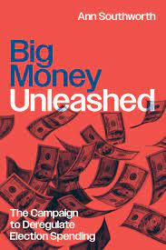
Panelists (live):
Ann Southworth, University of California at Irvine, Author
Tabatha Abu El-Haj, Drexel Kline Law School
Reva Siegel, Yale Law School
Bradley Smith, Capital University Law School
Mark Tushnet, Harvard Law School
Susan Carle, AU Washington College of Law, Moderator

Slide 2
Larry Lessig, Harvard Law School, appearing via video recording
https://media.wcl.american.edu/Mediasite/Play/f0f1f5215fb2469bbd79529682a88d731d
Link to full version to be posted after meeting.

Slide 3
a discount of 30% off orders through the University of Chicago Press with the code: BIGMONEY2023. The code is valid through October 2024.

